Slide 1
Digital Financial Literacy AI AGent
IBM AICTE PROJECT
Presented By : Mansi Upadhyay
Student name : Mansi Upadhyay
College Name : Galgotias University
Department : B.Tech Computer Science and Engineering(2023-27)

Slide 2
OUTLINE
Problem Statement
Technology used
Wow factor
End users
Result
Conclusion
Git-hub Link
Future scope
IBM Certifications

Slide 3
Problem Statement
Many individuals, especially in rural or non-English-speaking regions, struggle to understand and use digital financial tools safely. Manual awareness programs are limited in reach and cannot personalize education for diverse user needs.
Proposed Solution: An AI Agent for Digital Financial Literacy using RAG (Retrieval-Augmented Generation) to provide accurate, multilingual, and personalized financial guidance on:
• UPI usage
• Online scam prevention
• Interest rates
• Budgeting & saving
• Loan safety and more.

Slide 4
Technology used
IBM Cloud Lite Services
IBM Watsonx AI Studio
IBM Watsonx Agent Lab
IBM Granite Foundation Model
Retrieval-Augmented Generation (RAG)
Natural Language Processing (NLP)
Multilingual Translation APIs

Slide 5
IBM cloud services used
IBM Cloud Watsonx AI Studio
IBM Cloud Watsonx AI Runtime
IBM Agent Lab (Beta)
IBM Granite (for foundation model-based understanding)

Slide 6
Wow factors
This agent will drastically reduce financial confusion, protect users from scams, and empower every Indian — urban or rural — with digital money skills by making financial knowledge smart, simple, and secure. Unique features:
• Smart retrieval from RBI, NPCI, govt portals • Simplifies financial terms for beginners • Multilingual support for regional inclusivity • Scam alerts for fake UPI links & fraud apps • Personalized answers (e.g., safe loan for ₹10k/month earner) • Budgeting tips for low-income users • No app needed – works on low-end devices • Auto-updated with latest digital finance rules

Slide 7
End users
Students and Young Adults
Farmers and Rural Population
Senior Citizens
First-time Bank Users
Government Schemes Beneficiaries
Microbusiness Owners

Slide 8
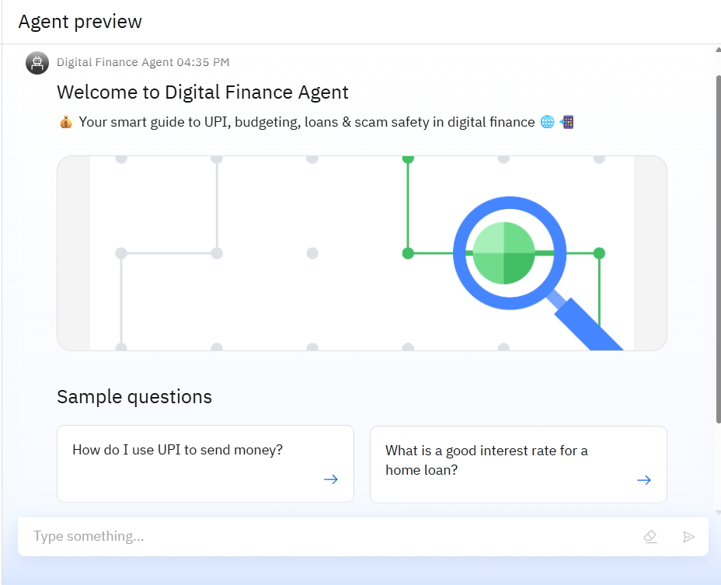
Results

Slide 9
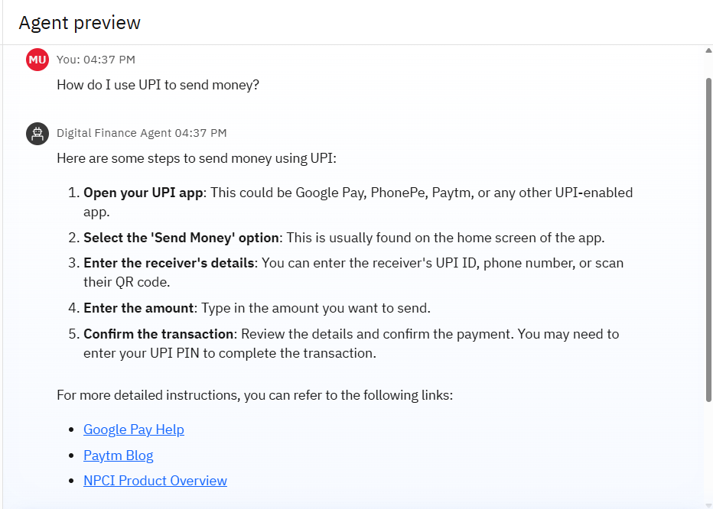
Results

Slide 10
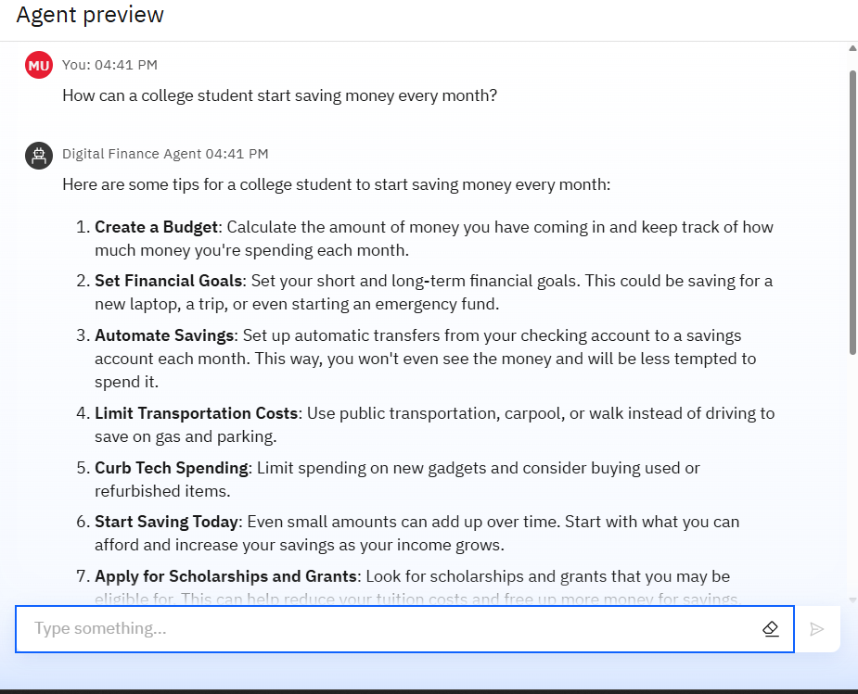
Results

Slide 11
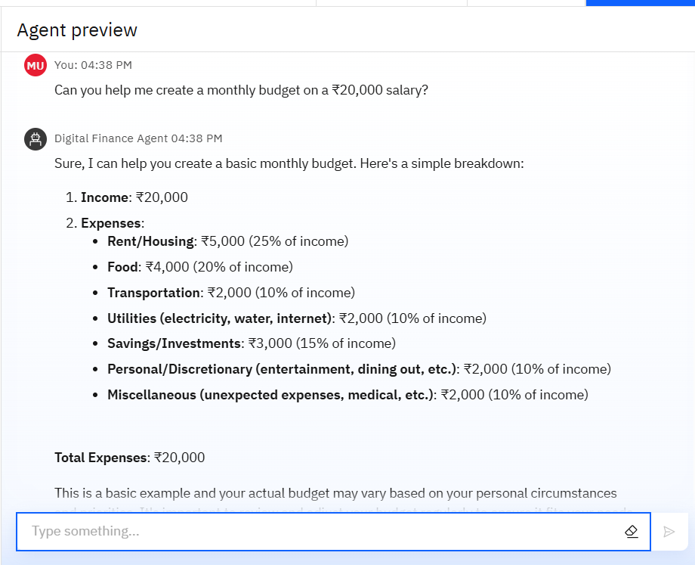
Results

Slide 12
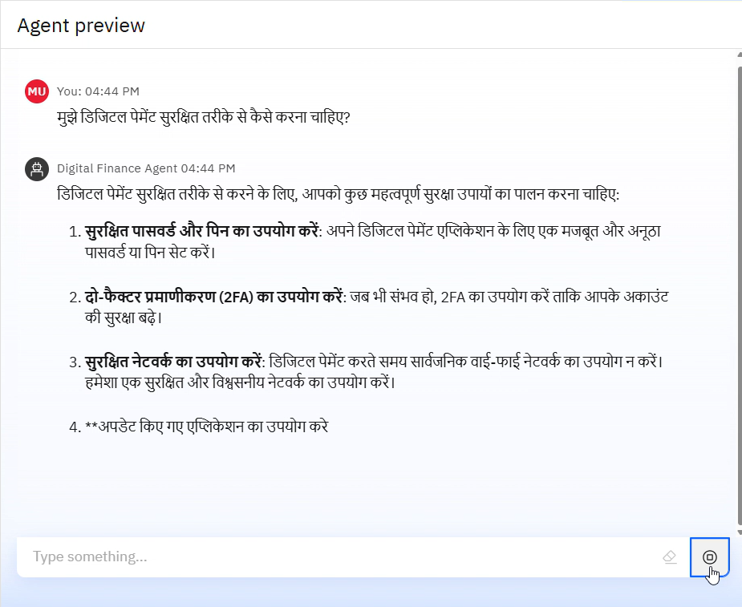
Results

Slide 13
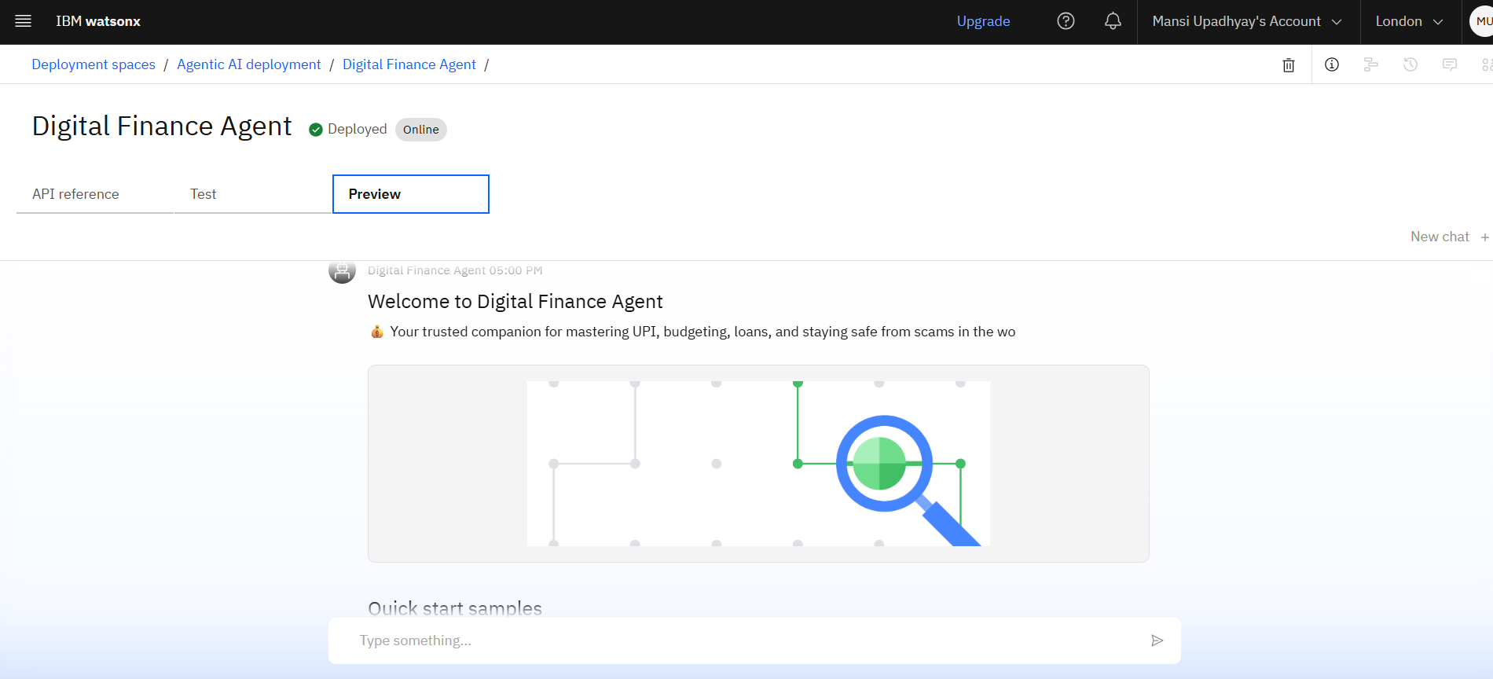
Results
Deployed AI Agent

Slide 14
Conclusion
This AI Agent for Digital Financial Literacy is not just a tool — it’s a mission to empower every citizen with the knowledge to make safe, smart, and confident financial decisions.
By combining trusted data, AI intelligence, and multilingual support, this agent bridges the gap between technology and trust, bringing financial freedom within everyone’s reach. A scalable, inclusive solution toward building a financially aware digital India.
It is a scalable, secure, and inclusive innovation that contributes to building a financially aware and digitally empowered India.

Slide 15
GitHub Link
https://github.com/Mansi-Upadhyay-12/Digital-Financial-Literacy-AI-Agent

Slide 16
Future scope
Chat-ready: Seamless integration with WhatsApp and chat platforms
See it, Ask it: Upload images/screenshots to get instant financial advice
Smarter Safety: AI that detects new fraud trends before they spread
Rural Reach: Lightweight mobile app built for offline and low-end users
Locally Trained: Region-aware AI that understands real user needs

Slide 17
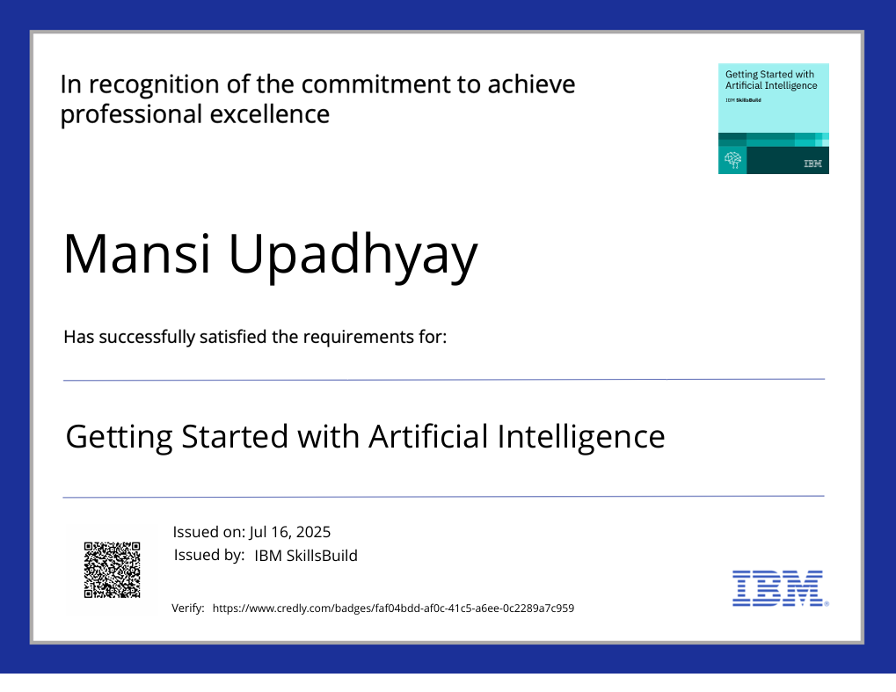
IBM Certifications

Slide 18
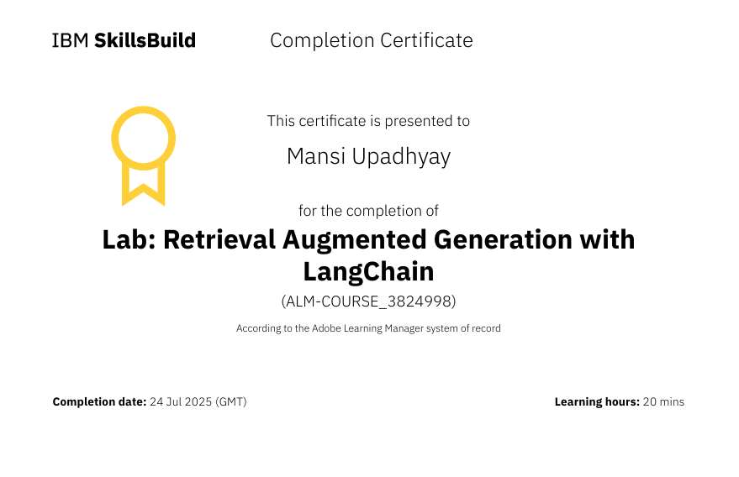

Slide 19
THANK YOU

